Slide 1
Nonlinear Human Population Growth Modeling – Upper Bias
Cole Prather

Slide 2
Data Compilation
Using available census data from the USCB, UN, and other sources, a “total” was established and deemed the “canonical” dataset.
This canonical set was compared to known historical events that significantly reduced the population:
Antonine Plague (165 – 180 AD)
Plague of Justinian (500 – 700 AD)
The Bubonic Plague (~ 1350 AD)

Slide 3
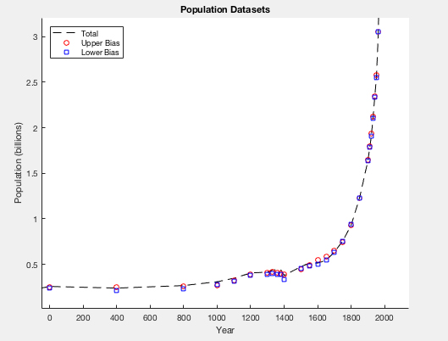
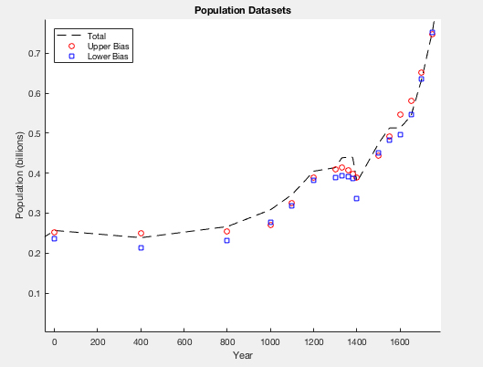
Formation of Upper Bias
From the comparison of canonical data to the aforementioned events, some data sets were eliminated accordingly and the remaining were deemed the “upper bias”.

Slide 4
Models
In order to derive a functional model of the human population over time, the Law of Mass Action and Chemical Kinetics are used to develop a relationship from known models:
Power
Logistic
Exponential

Slide 5
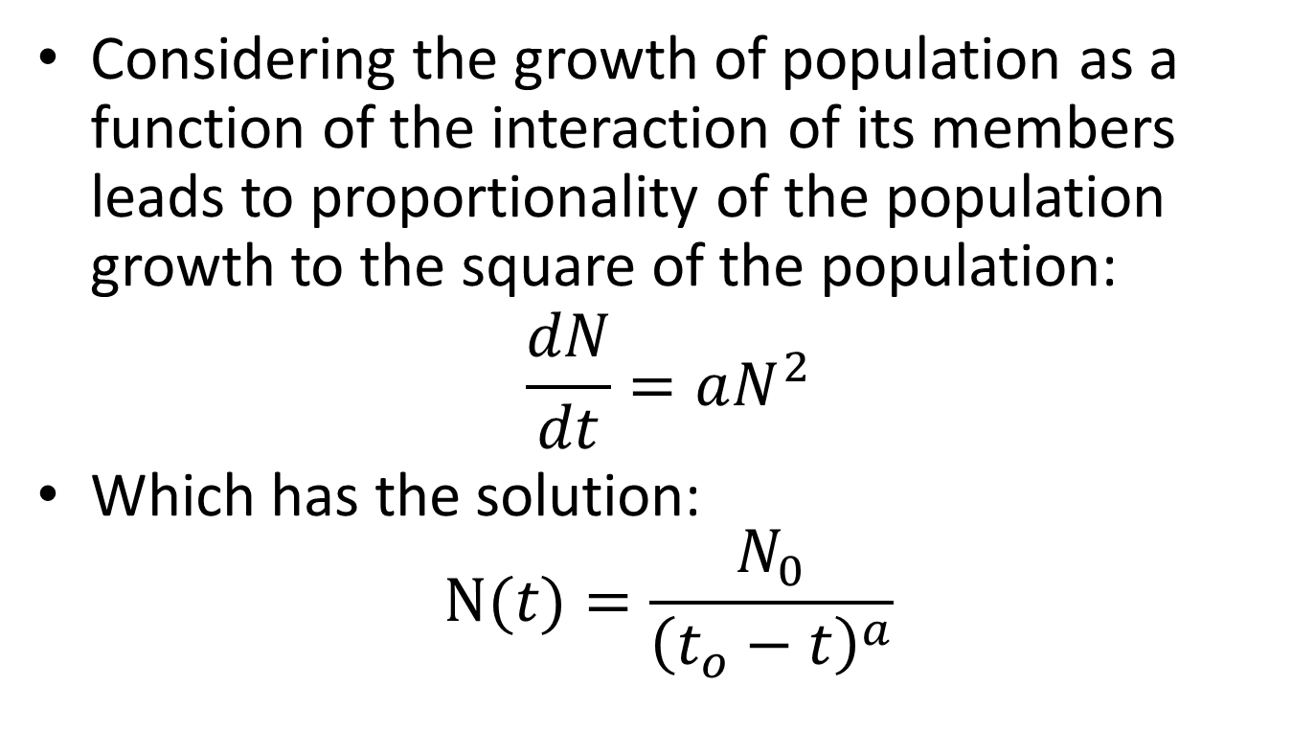
Power Model
Considering the growth of population as a function of the interaction of its members leads to proportionality of the population growth to the square of the population:
$$\frac{dN}{dt}=aN^{2}$$
Which has the solution: $N(t)=\frac{N_{0}}{{\left(t_{o}−t\right)}^{a}}$

Slide 6
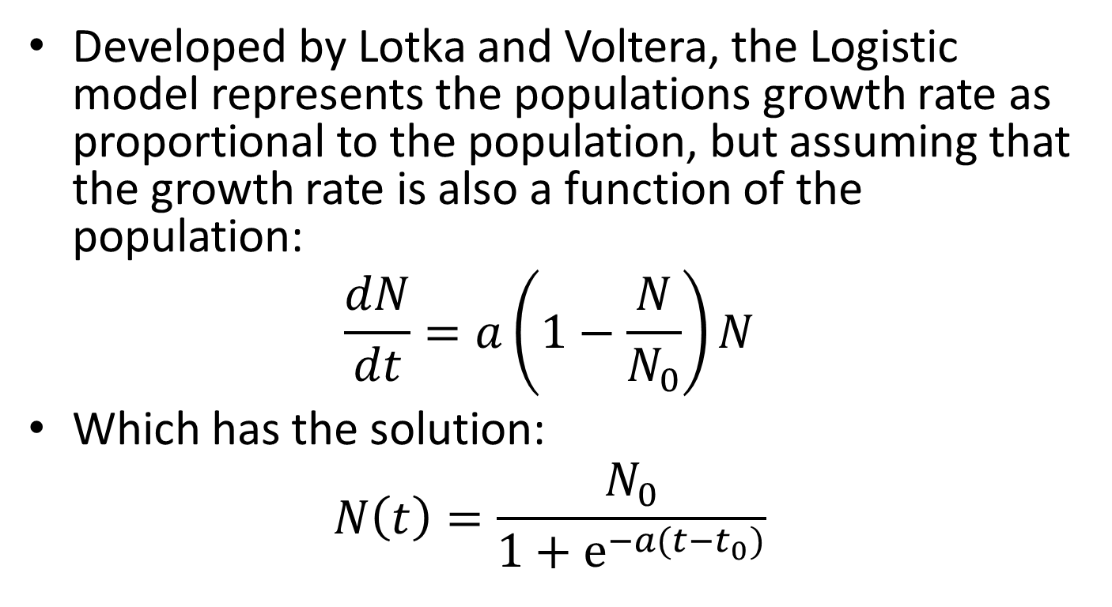
Logistic Model
Developed by Lotka and Voltera, the Logistic model represents the populations growth rate as proportional to the population, but assuming that the growth rate is also a function of the population:
$$\frac{dN}{dt}=a\left(1−\frac{N}{N_{0}}\right)N$$
Which has the solution:
$$N\left(t\right)=\frac{N_{0}}{1+e^{−a(t−t_{0})}}$$

Slide 7
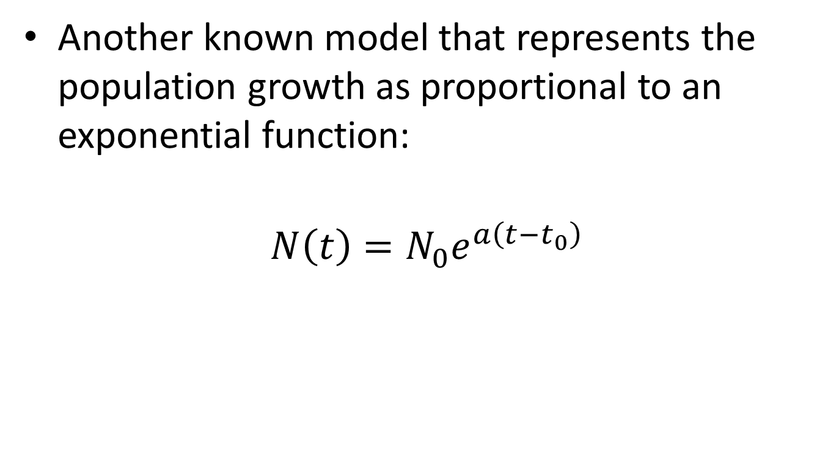
Exponential Model
Another known model that represents the population growth as proportional to an exponential function:
$$N\left(t\right)=N_{0}e^{a\left(t−t_{0}\right)}$$

Slide 8
Transition/Extinction Models
The Power, Logistic, and Exponential models of the population were then compared to other models:
Stabilization
Lambda
Dielectric
Extinction

Slide 9
Parameter Optimization
Using Excel’s Solver tool, the parameters of each model were optimized by a minimization routine on the sum of squares.
Error estimates for each parameter were also calculated.

Slide 10
Model Comparison
After completing the optimization for both a full data set (408 entries) and a recapitulated data set (41 entries), the sum of squares and R-squared values were compared for each of the models.

Slide 11
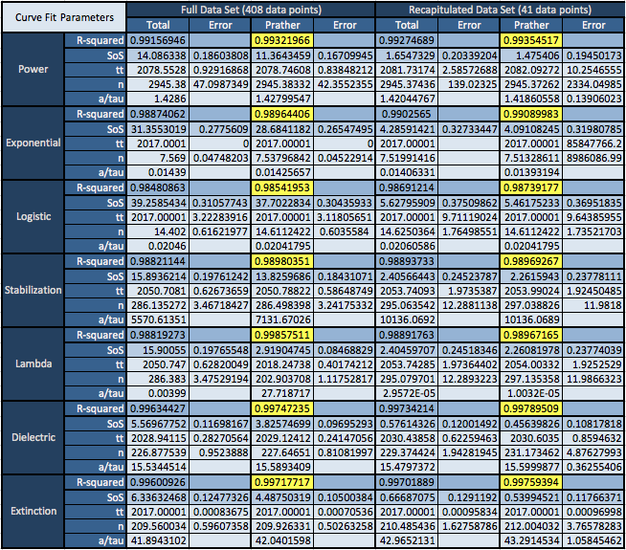
Model Comparison

Slide 12
Comparison Conclusions
Generally, the R-squared value improved for the recapitulated data.
The Power model was a better fit than both the Logistic and Exponential models.
The Dielectric and Extinction models had consistently high R-squared values for both data sets.

Slide 13
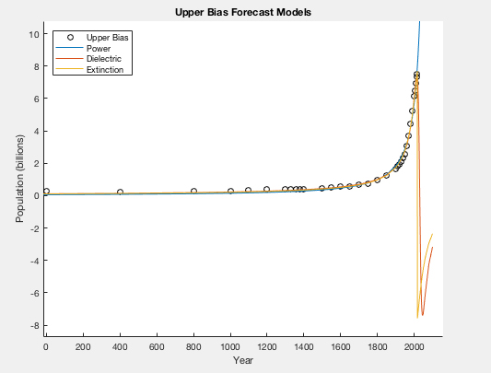
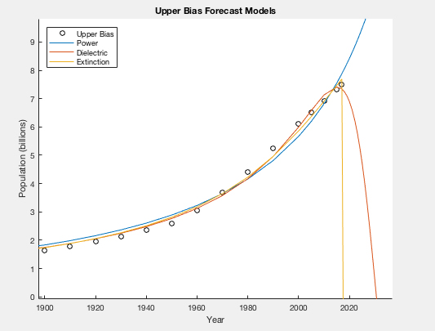
Forecasting
Having determined the best models, the optimized parameters of each were used to extrapolate forecasts.

Slide 14
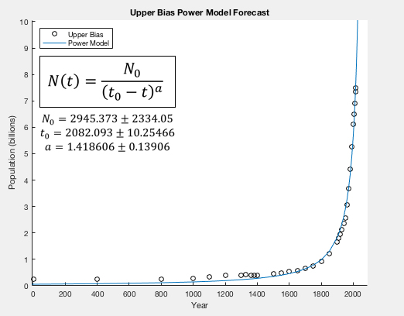
Power Model Forecast

Slide 15
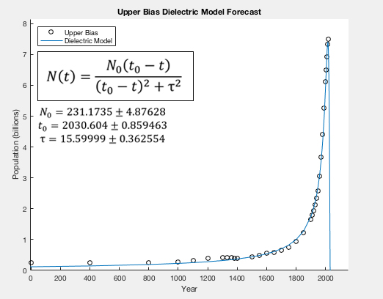
Dielectric Model Forecast

Slide 16
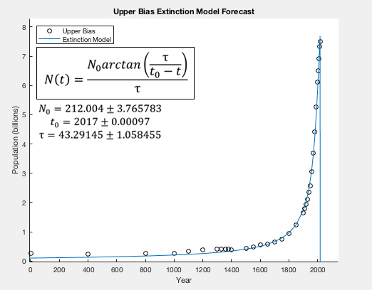
Extinction Model Forecast

Slide 17
Preliminary Conclusions
The power model has a large error associated with one of its parameters, and although having a high R-squared value, it is unlikely that the population will continue increasing indefinitely.
The Extinction model reaches a critical point at the last known input (2017) thus is not likely an accurate prediction.
The Dielectric model remains the most likely description of human population growth.

Slide 18
Citations
Literature:
1. de Levie, Robert. “Estimating Parameter Precision in Nonlinear Least Squares with Excel's Solver.” ACS Publications, Journal of Chemical Education, 11 Nov. 1999, pubs.acs.org/doi/pdf/10.1021/ed076p1594.
2. Harris, Daniel C. “Nonlinear Least-Squares Curve Fitting with Microsoft Excel Solver.” ACS Publications, Journal of Chemical Education, 1 Jan. 1998, pubs.acs.org/doi/pdf/10.1021/ed075p119
3. Nisbet, I. C. T. “Mathematical Ecology.” BioScience, vol. 20, no. 21, 1970, pp. 1180–1180.
4. Péter Érdi; János Tóth (1989). Mathematical Models of Chemical Reactions: Theory and Applications of Deterministic and Stochastic Models. Manchester University Press. p. 3. ISBN 978-0-7190-2208-1.
5. Pielou, Evelyn C. "An introduction to mathematical ecology." An introduction to mathematical ecology. (1969).
6. Nonlinear Saturation Model of World Population Growth, Reza Mofid and Weldon J. Wilson 2010
7. Nonlinear Models of World Population Growth, Alan Harris and Weldon J. Wilson 2009
8. A Predator-Prey Model of World Population Growth; Weldon J. Wilson 2006
Data Sources:
www.aae.wisc.edu/aae641/Notes/World_Population.docx
https://www.census.gov/population/international/data/worldpop/table_history.php
http://www.scottmanning.com/archives/World%20Population%20Estimates%20Interpolated%20and%20Averaged.pdf
http://www.worldometers.info/world-population/world-population-by-year/
https://www.un.org/esa/population/publications/sixbillion/sixbilpart1.pdf
https://esa.un.org/unpd/wpp/DataQuery/
https://www.census.gov/population/international/data/worldpop/table_population.php
http://data.worldbank.org/indicator/SP.POP.TOTL?end=2015&start=2015&view=map&year=1960

Slide 19
Acknowledgements
Chris Fickess
Dr. Weldon Wilson
STLR Grant
RCSA Grant

